Slide 1
Data Stream Mining RE-DI & DWM
Daniel Minguez Camacho

Slide 2
Intro
Resample-based Ensemble Framework for Drifting Imbalanced Data Streams (RE-DI)
Dinamic weight mayority (DWM)
Implementation, results, problems and posible solutions

Slide 3
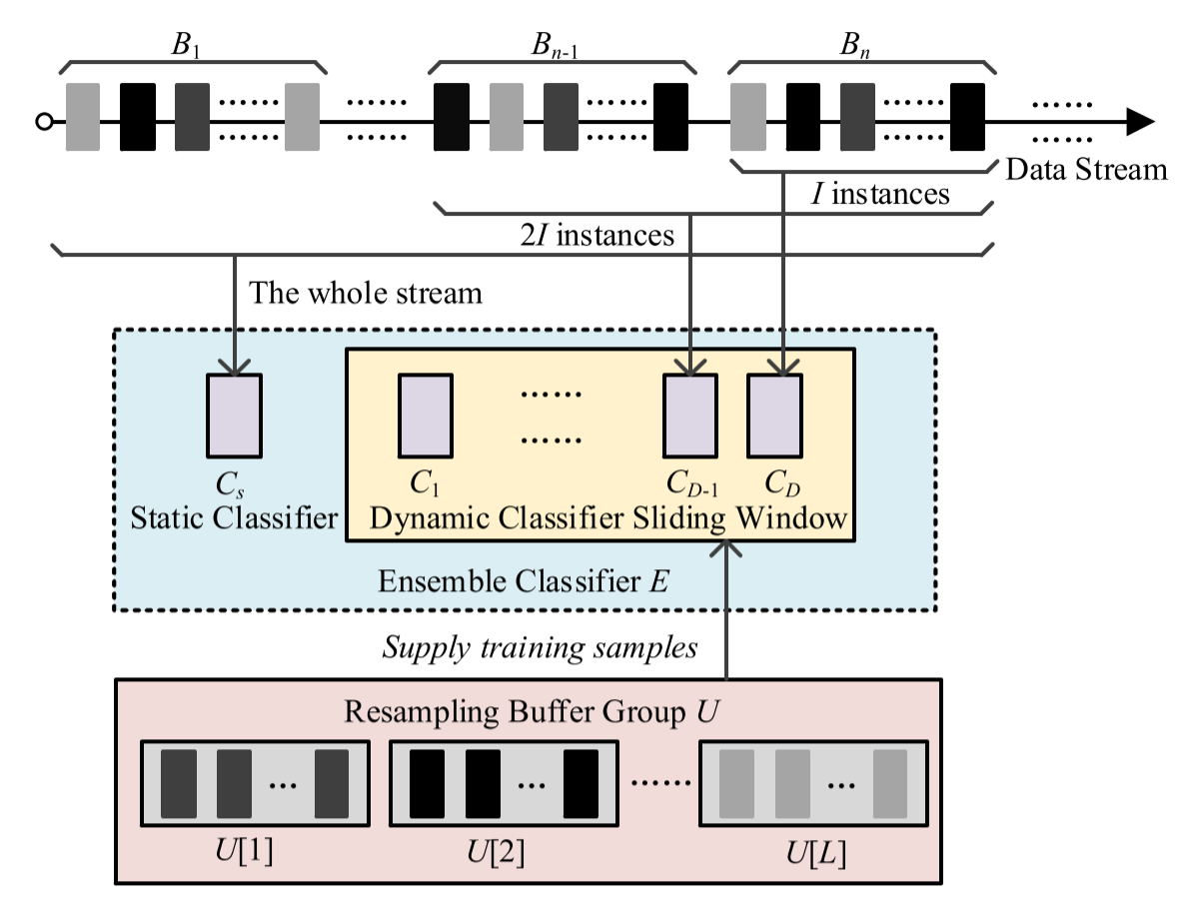
RE-DI

Slide 4
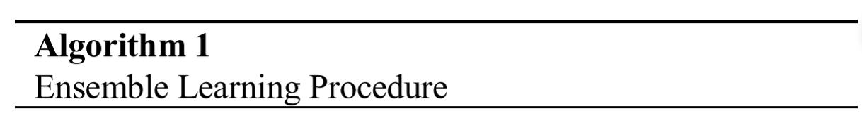
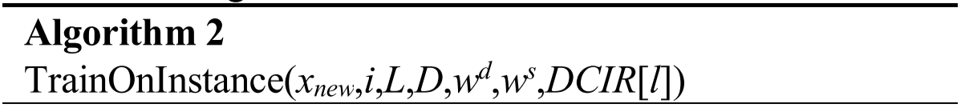
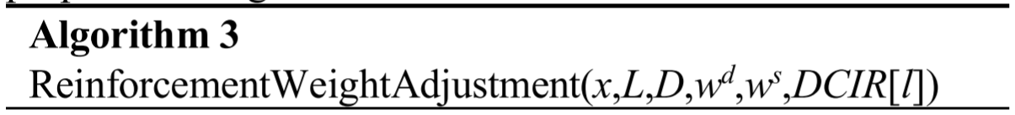
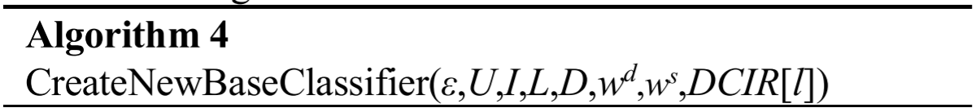
Implementation

Slide 5
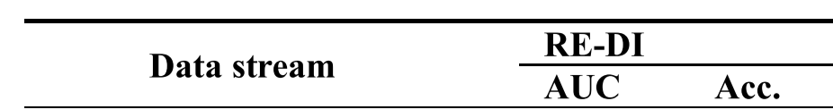
Results
Prequential AUC – ACC
DEFAULT: D=10, I=500, and ε=0.2

Slide 6
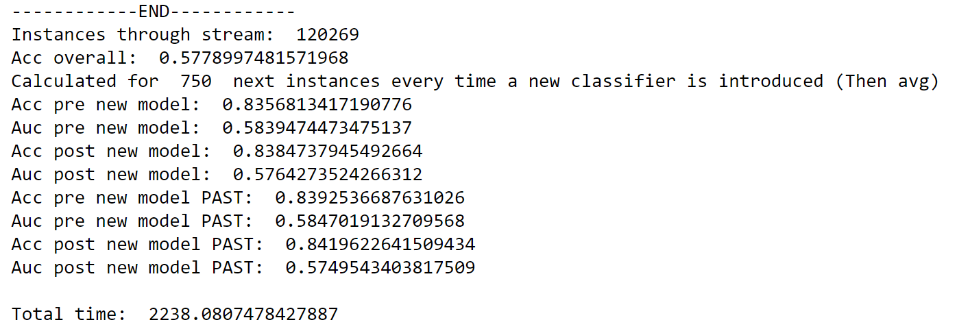
Results
Where did they evaluated the model?

Slide 7
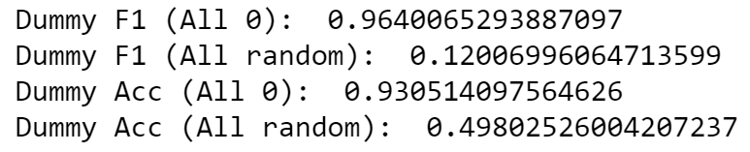
Results
Some alternatives: Micro-F1

Slide 8
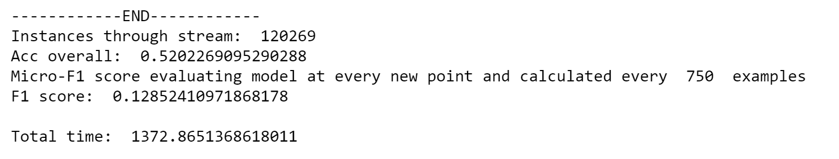

Results
Still nothing

Slide 9
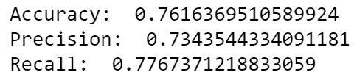
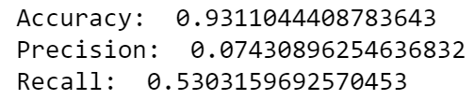
Other tests performed
1 Hoeffing tree over balanced sample:
1 Hoeffing tree over unbalanced sample:

Slide 10
Posible problems
Different dataset preprocessing changes previous to model training, normalization?
Algorithm evaluated in different points in time
Difference in Hoeffing Tree implementation (Python vs MOA)
Implementation?

Slide 11

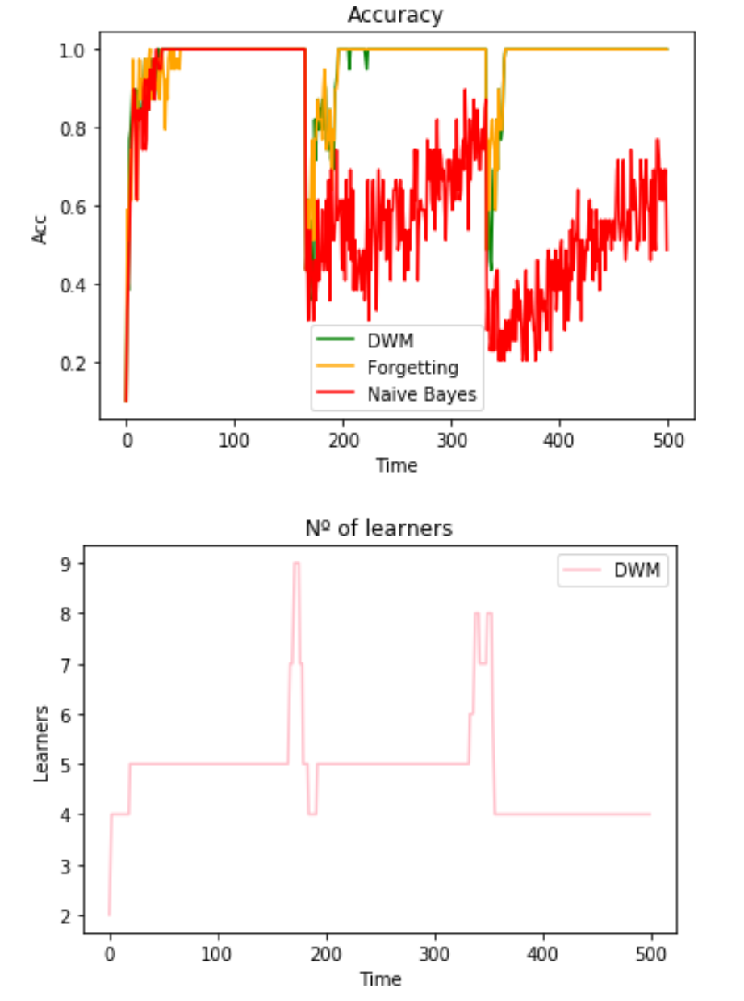
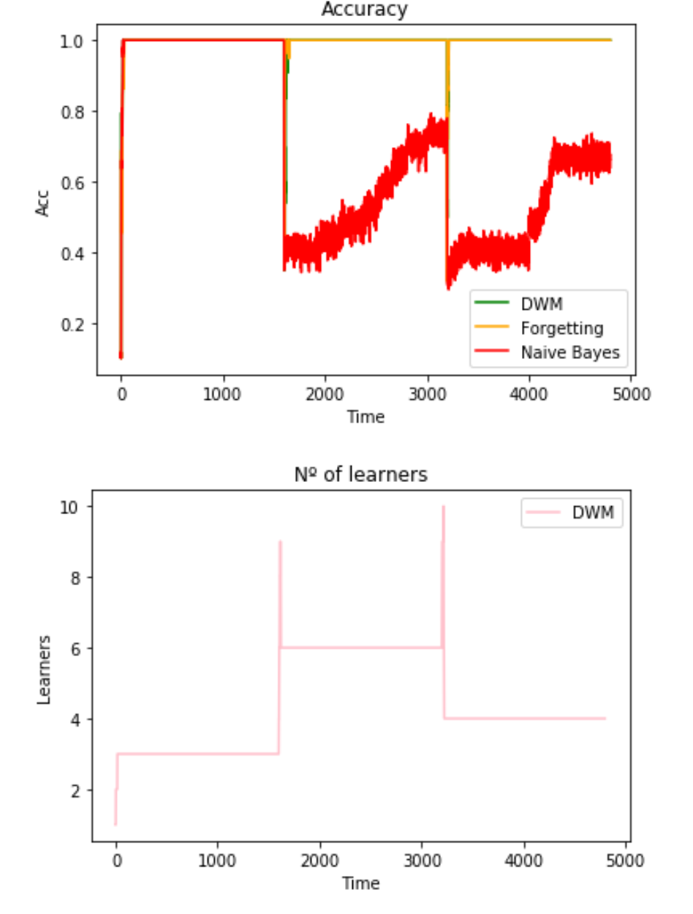
DWM
Just in case….

Slide 12
Thank you!!

